Slide 1
Introduction to SQL
420-D10 Database I – S05
References:
https://en.wikipedia.org/wiki/SQL

Slide 2
Reference
https://en.wikipedia.org/wiki/SQL#Queries
Read this, you have to know it
(yes, the overview of SQL will be covered on the tests)

Slide 3
Objectives
Understand SQL
History – where it came from
Function – what it does

Slide 4
SQL – what is it?
Structured Query Language (SQL)
The language you use to interact with a DBMS
The name is a lie!
(more on this later)
Notes:
QUIZ – anyone know why the name is a lie?

Slide 5
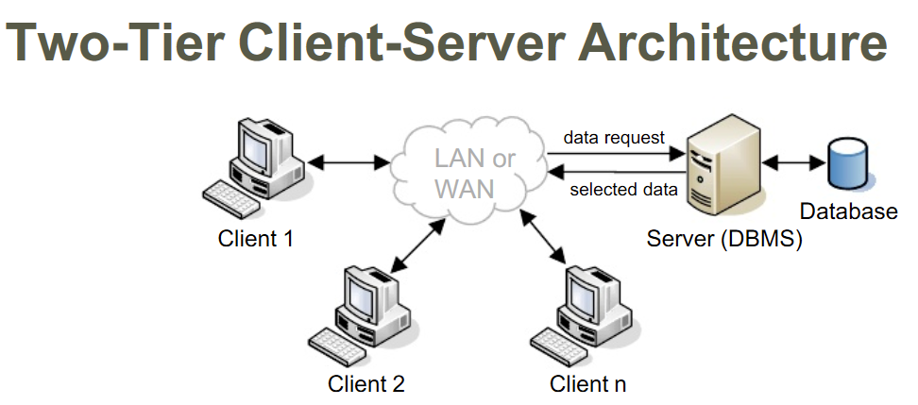
SQL is the API
SQL is the syntax used to communicate to the DBMS
Notes:
In your labs what Client did you use to talk to the DBMS?
(Oracle SQL Developer)
Whiteboard – sequence diagram of select statement from client to DBMS

Slide 6

History
Late 1970’s
SEQUEL
Structured English QUEry Language
IBM
Renamed to ‘SQL’ due to trademark dispute
Adopted by Oracle and commercialized (1979)
1986
Standardized by ANSI and ISO
Not fully adopted by many vendors
Many portability issues from vendor to vendor
Notes:
General prolifieration and forking until standardized by ANSI (American National Standards Institute)
Portability will be covered in the Lab

Slide 7
Design
Subsets
DML
Data Manipulation Language
Add, update, delete data
DDL
Data Definition Language
Table and index structure
DCL
Data Control Language
Authorize user access
TCL
Transaction Control Language
Notes:
You’ll learn some of these other aspects later, for now, just an overview that there’s more to SQL than just “Select”
This is why the name is a lie. It’s not just a query language it can also define and modify the database.

Slide 8
More to come later this semester
More functions in the query side (math, grouping, filters/criteria)
Understanding multi-table joins
Notes:
Samples of what SQL can do:
http://www.itl.nist.gov/div897/ctg/dm/sql_examples.htm

